Slide 1

REALTOR® Action Fund (RAF) &
REALTOR® Action Assessment (RAA)
How it Works to Support Your Association

Slide 2
Introduction
RAF
REALTOR® Action Fund, which is a voluntary investment.
How does my RAF investment support our Association?
RAF participation drives engagement and investment, and in return, RAA allocation reflects that participation by determining how much funding comes back to support our local efforts.
RAA
REALTOR® Action Assessment, which is mandatory.

Slide 3
RAF Breakdown
$200
Federal Advocacy
State Advocacy
Local Association
(30%)

Slide 4
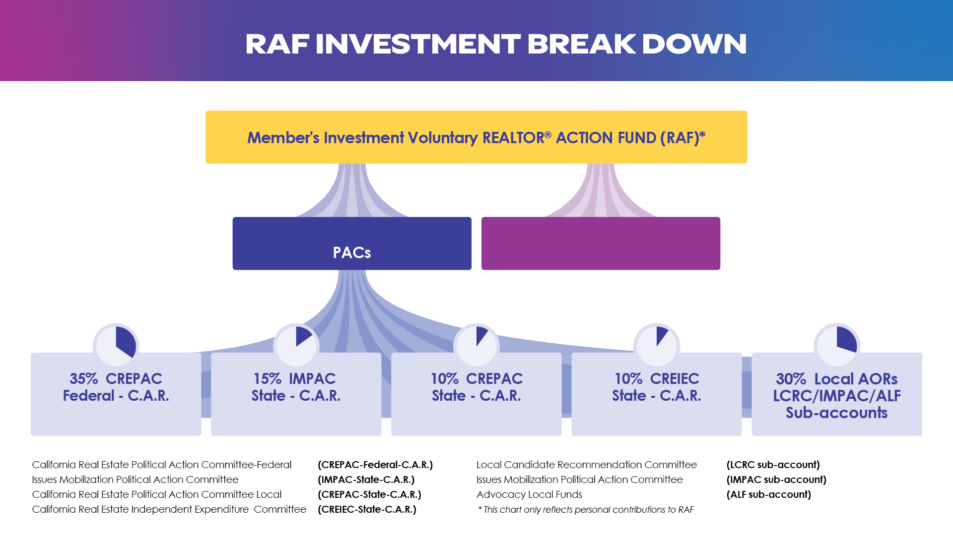

Example: $49 Investment
Assuming a split of 30/30/40
Your Local AORs 30% ($14.70)
LCRC - IMPAC - ALF-Sub-accounts
LCRC - $4.41 =30%
IMPAC-$4.41=30%
ALF-$5.88=40%
Member’s
Investment $49
$49
$201-5,000
CREPAC-Federal-C.A.R.
$17.15
$7.35
$4.90
$4.90

Slide 5
Example: $148 Investment
Assuming a split of 30/30/40
Your Local AORs 30% ($44.40)
Your Local AORs
LCRC - $13.32 =30%
IMPAC-$13.32=30%
ALF-$17.76=40%
Member’s
Investment $148
$148
$201-5,000
CREPAC-Federal-C.A.R.
$51.80
$22.20
$14.80
$14.80

Slide 6

Higher Investments ($449 / $1,000)
For larger investments, the first $200 is allocated using the same structure, and any amount above that is allocated directly to federal advocacy efforts.
$449 = $249 to CREPAC/Federal and
$1000 = $800 to CREPAC/Federal
This ensures we remain strong and effective at the local, state, and national levels.

Slide 7
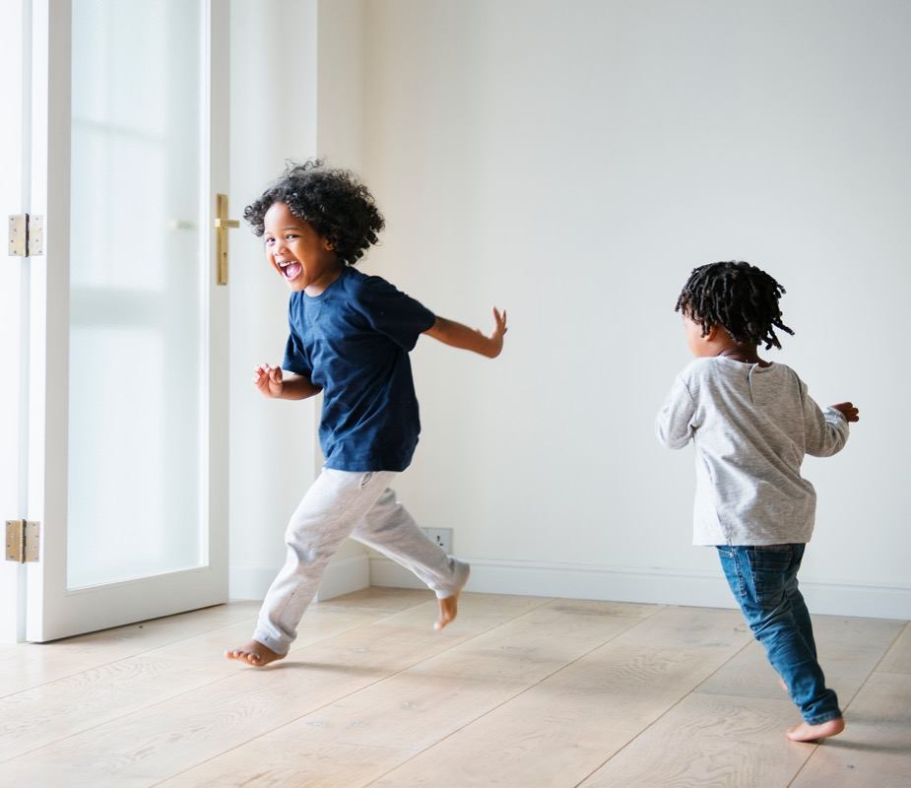
WHAT COMES BACK:
Connecting RAF Participation to RAA Funding
How our participation influences how much funding we receive back through the RAA.

Slide 8
RAA Allocation Overview
The REALTOR® Action Assessment, or RAA, is mandatory—but the amount allocated back to our Association is performance-based.
It is directly linked to our RAF participation and overall performance.
If our participation is below 12%
We receive 5%
If we meet the minimum
but are below the goal
We receive 15%
If we meet key benchmarks,
like $20 per member or the RAF goal
We receive 17%
If we exceed the RAF goal by 5%
We can receive
up to 20%

Slide 9
Current Participation & Path to Goal
32
13%
21%
$5,455
Participation
Goal
Additional investors needed to reach goal
Current RAF Raised
Current Participation
To find your data
Click Here

Slide 10
Here’s what that means:
At 12% participation, Your Local Association would receive 15% of our RAA in 2027.
At 21% participation (meeting goal), Your Local Association would receive 17% of their RAA in 2027.
If Your Local Association does not meet the participation goal but averages $20 per member, Your Local Association stills receive 17% of our RAA in 2027.
At 26% participation (5% above goal), Your Local Association would receive 20% of their RAA in 2027.
Participation & RAA IMPACT
The starting point for how much RAA you receive depends on where you are on slide 9.

Slide 11
Why It Matters
That’s why participation matters so much.
Whether it’s $49, $148, or more—every investment helps strengthen our voice and increases the resources we bring back to support our members and our industry.
RAF participation isn’t just about investing—it directly impacts the resources we bring back to our Association.

Slide 12

Moving Forward Together
Every additional investor makes a difference.
It doesn’t just grow participation—it increases the resources we bring back to our Association.
We appreciate your continued support and leadership.

Slide 13
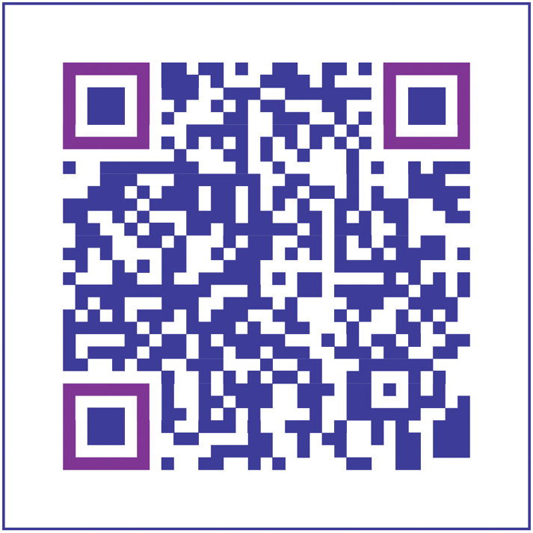
Make Your Investment

